Slide 1
Cryptographic System Standards

Slide 2
Context
So far, we have covered:
Background and history of cryptography
Symmetric key cryptography (AES)
Assymetric cryptography (RSA)
Key exchange (Diffie Hellman)
Hashing (SHA-1)
Now we will put all of this together to see how a complete, end-to-end cryptographic system works in practice. We will use Boyle’s Corporate Computer Security textbook slides.
Some information will be repeating from earlier lectures.
This is the last lecture in our cryptography series.

Slide 3
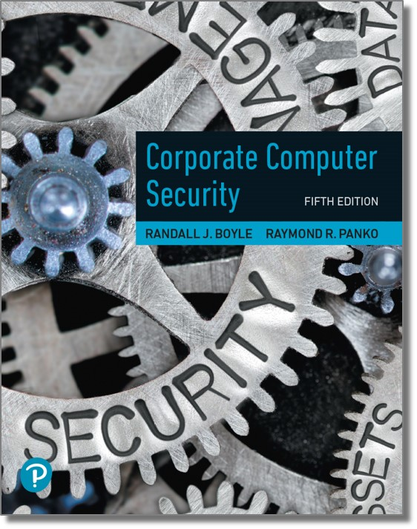
Corporate Computer Security
Fourth Edition
Chapter 3
Cryptography
Copyright © 2021, 2015, 2012 Pearson Education, Inc. All Rights Reserved
Notes:
If this PowerPoint presentation contains mathematical equations, you may need to check that your computer has the following installed:
1) MathType Plugin
2) Math Player (free versions available)
3) NVDA Reader (free versions available)

Slide 4
3.3: Cryptographic System Standards
Cryptographic Systems
A packaged set of cryptographic countermeasures for protecting dialogues
When two parties communicate using a cryptographic system, they need to use a specific cryptographic system standard

Slide 5
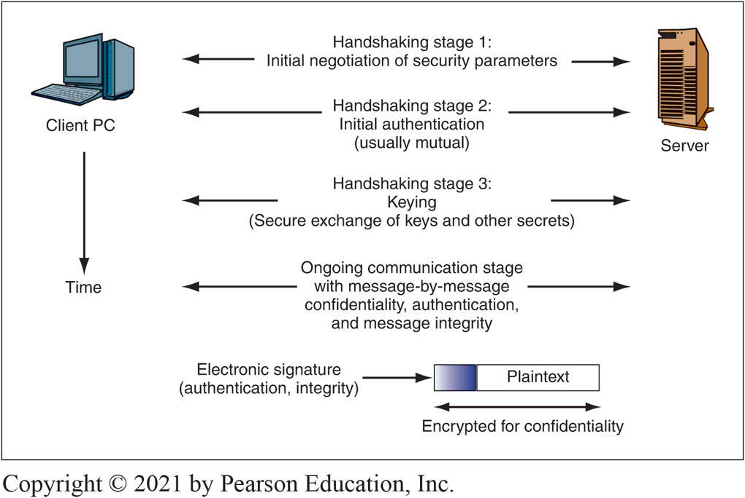
Figure 3-8: Cryptographic System Stages
Notes:
When two parties (devices or programs) begin to communicate via a cryptographic system standard, they go through three handshaking stages, as shown here.
Long Description:
The illustration shows the following stages of converting an electronic signature (authentication, integrity) into plaintext, the latter labeled as encrypted for confidentiality, between a client PC and a server with the passage of time.
1. Handshaking stage 1: Initial negotiation of security parameters.
2. Handshaking stage 2: Initial authentication (usually mutual).
3. Handshaking stage 3: Keying (Secure exchange of keys and other secrets).
4. Ongoing communication stage with message-by-message confidentiality, authentication, and message integrity.

Slide 6
3.4: The Negotiation Stage
Cipher Suite Options
A cipher suite is a specific set of security methods and options for a particular cryptographic system standard (e.g., SSL/TLS)
Includes specific set of methods and options for initial authentication, key exchange, and ongoing message confidentiality, authentication, and integrity

Slide 7
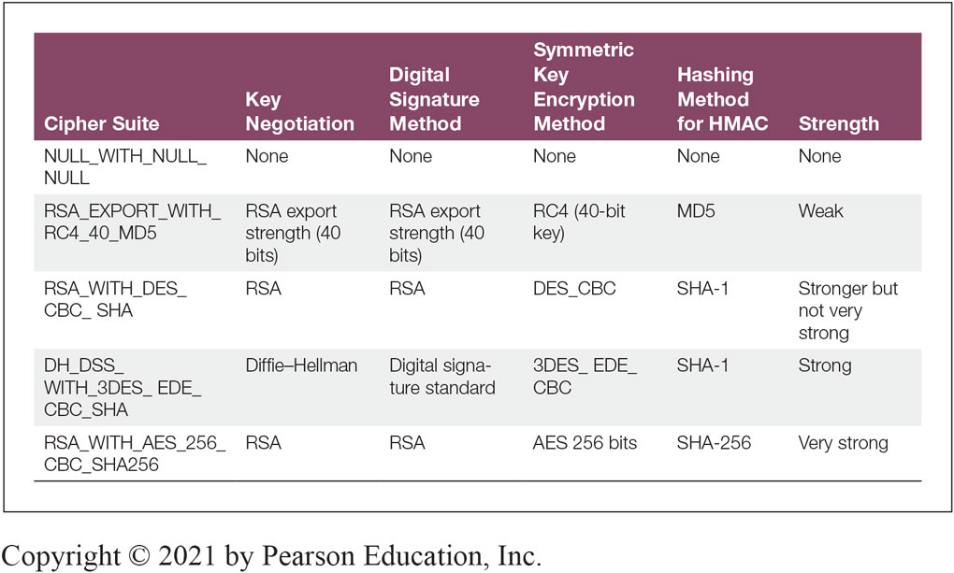
Figure 3-9: Selected SSL/TLS Cipher Suites
Notes:
This figure shows a small subset of optional cipher suites offered by the popular SSL/TLS standards discussed later in this chapter. They are shown in order of increasing cryptographic strength.

Slide 8
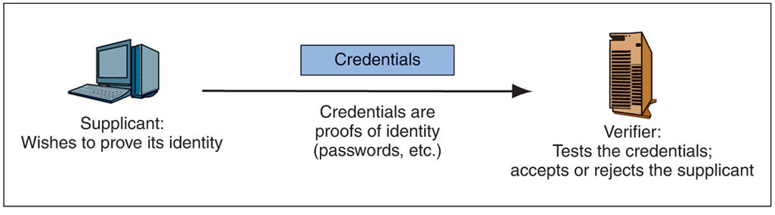
3.5: Authentication: Supplicant, Verifier, and Credentials
Notes:
In authentication, the party trying to prove its identity is called the supplicant. The other party is the verifier. The supplicant sends credentials (proofs of identity) to the verifier (see figure here). In mutual authentication, the two parties take turns being supplicants and verifiers.

Slide 9
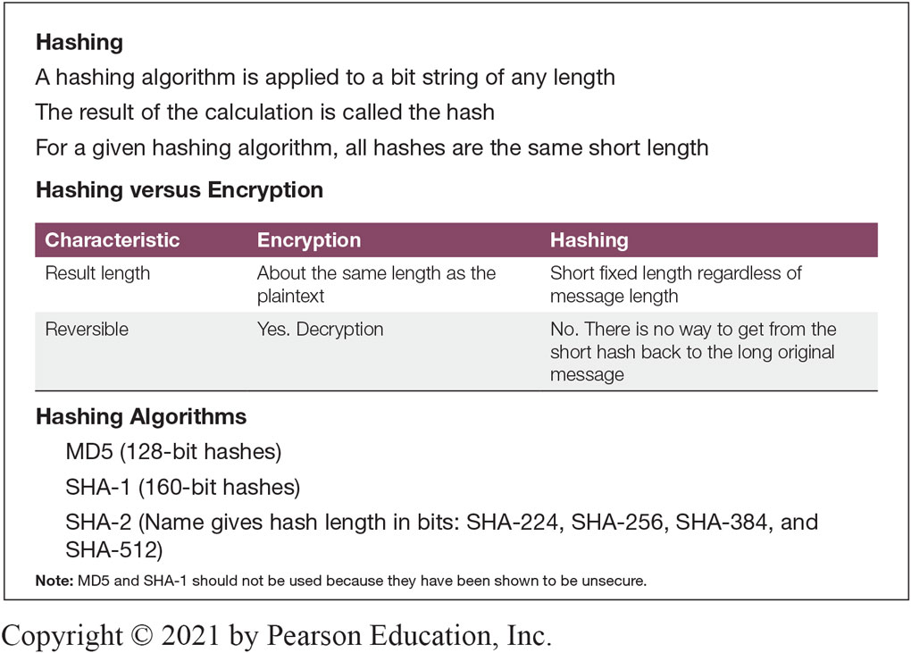
Figure 3-11: Hashing
Notes:
This figure offers information about hashing.
When hashing is applied to a binary message, the result (called the hash) is far shorter than the original message—typically only 128 to 512 bits long. By contrast, encryption produces ciphertext that is about as long as the plaintext.
Unlike encryption, which can be reversed by decryption, hashing is irreversible.

Slide 10
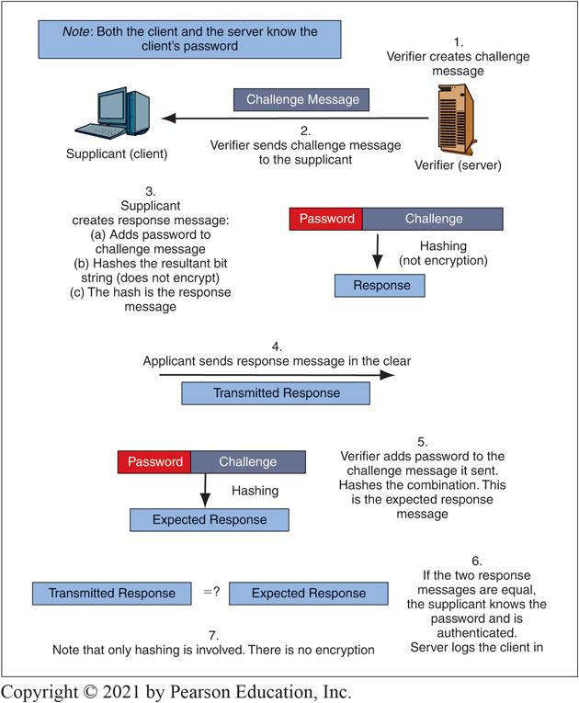
Figure 3-12: Microsoft Challenge Handshake Authentication Protocol (MS-CHAP)
Notes:
This figure illustrates the Microsoft Challenge Handshake Authentication Protocol (MS-CHAP).19 MS-CHAP is widely used when users log into a server running the Microsoft Windows Server operating system. The password becomes a shared secret known by both the supplicant (the user) and the verifier (the server). The supplicant authenticates himself or herself by proving that he or she knows the password for a particular account.
Long Description:
The illustration begins with a text on the top that reads, Note: Both the client and the server know the client’s password.
It further shows the following stages of the MS-CHAP process between a PC marked as Supplicant (client) and a server marked as Verifier (server).
1. Verifier creates challenge message.
2. Verifier sends challenge message to the supplicant
3. Supplicant creates response message: (a) Adds password to challenge message (b) Hashes the resultant bit string (does not encrypt) (c) The hash is the response message.
4. Applicant sends response message in the clear (marked as transmitted response).
5. Verifier adds password to the challenge message it sent. Hashes the combination. This is the expected response message.
6. If the two response messages are equal, the supplicant knows the password and is authenticated. Server logs the client in.
7. Note that only hashing is involved. There is no encryption.

Slide 11
3.6: The Keying Stage (1 of 2)
There are two types of ciphers used for confidentiality
In symmetric key encryption for confidentiality, the two sides use the same key
For each dialogue (session), a new symmetric key is generated: the symmetric session key
In public key encryption, each party has a public key and a private key that are never changed
A person’s public key is available to anyone
A person keeps his or her private key secret

Slide 12
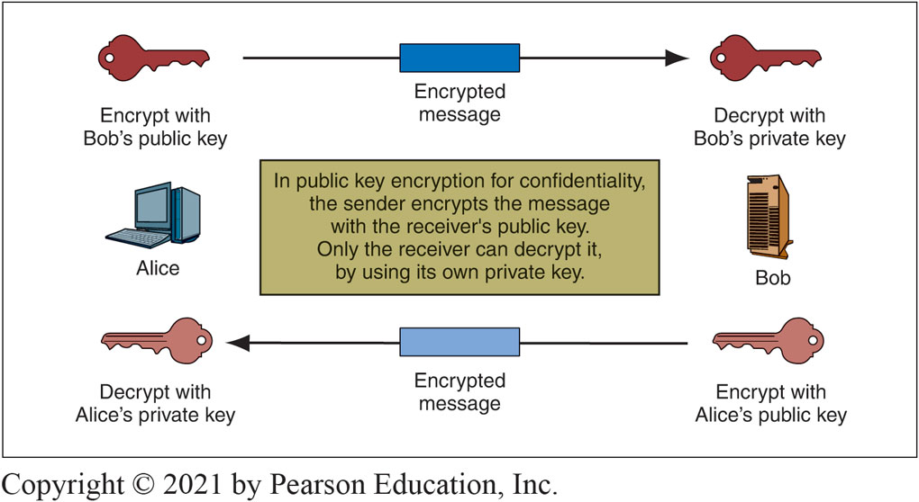
Figure 3-13: Public Key Encryption for Confidentiality
Notes:
In this figure, Alice wishes to send a message securely to Bob. Alice encrypts the plaintext with Bob’s public key. At the receiving end, Bob decrypts the ciphertext using his own private key. Note that we cannot simply say “the public key” and “the private key” because each side has a public key and a private key.

Slide 13
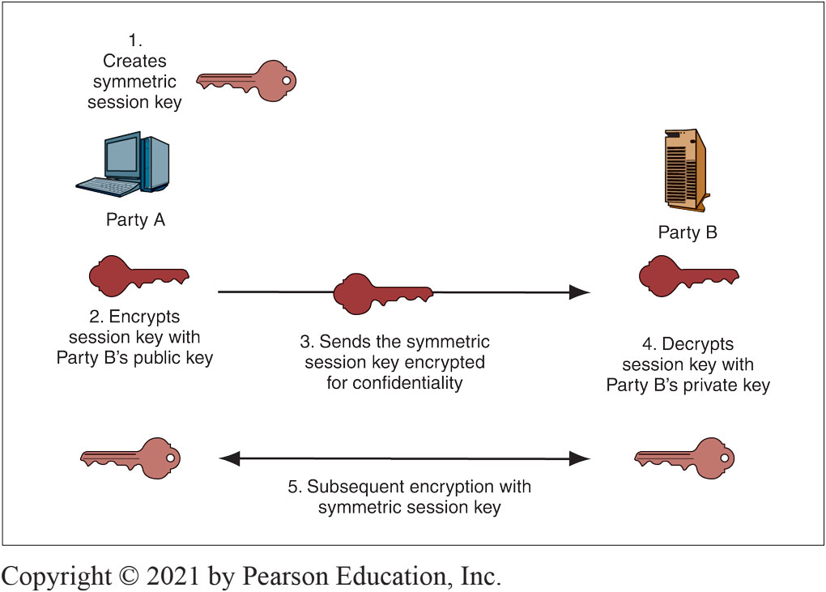
Figure 3-14: Public Key Keying for Symmetric Session Keys
Notes:
Although public key encryption and symmetric key encryption may seem like rivals, they actually are complementary. For example, public key encryption can deliver symmetric
session keys securely, as shown here:
• First, one side (Party A) generates a random bit string that will be used as a symmetric session key.
• Second, Party A encrypts this symmetric session key with the public key of the other party (Party B). Because this key is public, there is no need for a prior secret key distribution as there is with symmetric key encryption for confidentiality.
• Third, Party A sends this encrypted session key to Party B.
• Fourth, Party B decrypts the encrypted session key with Party B’s own private key. It can now read the original plaintext, which is the symmetric session key generated by the other party.
• Fifth, now that the keying is complete, both sides have the symmetric session key and will use it to send messages confidentially using symmetric key encryption.

Slide 14
3.6: The Keying Stage (2 of 2)
Diffie-Hellman key exchange
Fast public key encryption
Named for the two creators of public key encryption, who also created this keying method

Slide 15
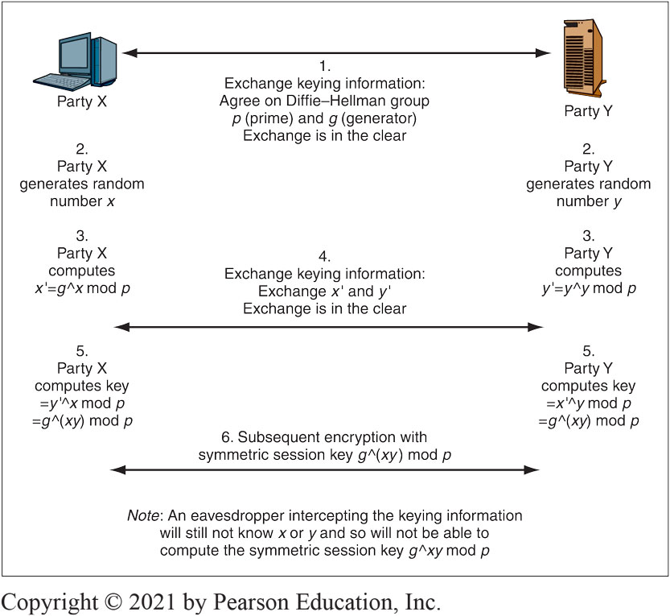
Figure 3-15: Keying Using Diffie-Hellman Key Agreement
Notes:
This figure shows that the two sides exchange keying information in the first two exchanges (Steps 1 and 4). If you are mathematically inclined, you can follow the process in detail, but we will only look at the most important highlights.
Using this keying information plus information that each side does not transmit (random numbers x and y), the two sides each compute the same symmetric key (gxy mod p). They then use this key as a session key for subsequent symmetric key encryption (Step 6).

Slide 16
3.7: Message-by-Message Authentication (1 of 10)
Message-by-message authentication can protect messages against man-in-the-middle and replay attacks
Man-in-the-middle (MITM) attack
Form of attack in which an attacker intercepts messages being sent between two parties and forward them on
Replay attack
Occurs when an attacker intercepts an encrypted message and transmits it again later

Slide 17
3.7: Message-by-Message Authentication (2 of 10)
Electronic signature
Provides both authentication and message integrity
Two common types
Digital signatures
Key-hashed message authentication codes (HMACs)
True party
The person the supplicant claims to be

Slide 18
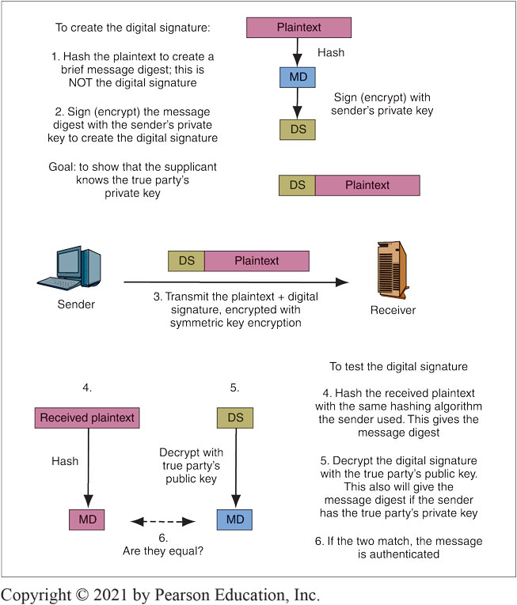
Figure 3-16: Digital Signature for Message-by-Message Authentication
Notes:
This figure shows how to create a digital signature, which authenticates a single message with public key encryption. The process is roughly analogous to the way human signatures authenticate documents.
The first step (1) in creating a digital signature for authentication is to hash the plaintext message. The resulting hash is called the message digest. In the second step (2), the sender encrypts the message digest with the sender’s own private key. Note that the sender used his or her own private key, not the receiver’s public key. This step creates the digital signature. The third step (3) in using a digital signature for authentication is to send the message. In step four (4), the verifier hashes the original plaintext message with the same hashing algorithm the supplicant used. This should produce a message digest. In step five (5), the verification process begins and the receiver first decrypts the digital signature with the true party’s public key, which is widely known. Finally, in step six (6) the message digests are compared.

Slide 19
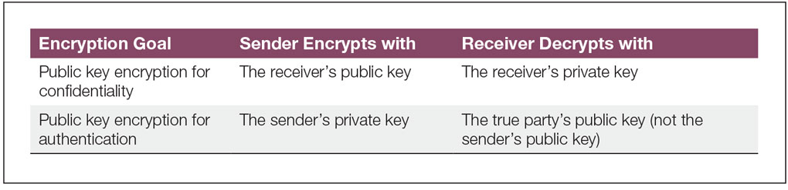
Figure 3-17: Public Key Encryption for Confidentiality and Authentication
Notes:
Public key encryption is used for both confidentiality and authentication. A frequent source of confusion for students is that public key encryption uses different keys for these two goals. This figure illustrates these differences.

Slide 20
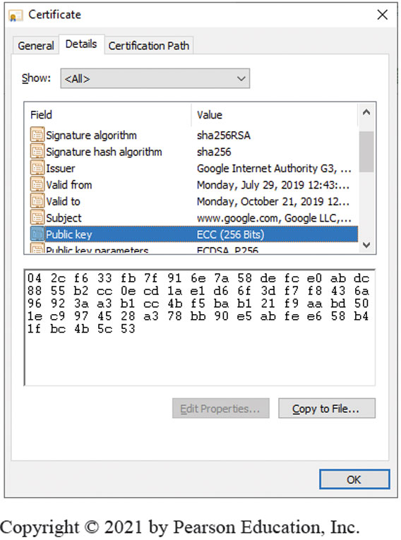
Figure 3-19: Digital Certificate for Google.com
Notes:
A digital certificate contains a number of fields, which are shown in Figure 3-18. Most importantly, the digital certificate contains the name of the true party (in the Subject field) and the true party’s public key (in the Public Key field as shown in this figure. The verifier looks up the digital certificate of the true party, then uses this public key in the digital certificate to test the digital signature of the supplicant.
How does the verifier know that the digital certificate is legitimate?
First, the verifier must check that the digital certificate is authentic and has not been modified.
Second, each digital certificate has dates before which and after which it is not valid. The receiver must check whether the digital certificate is in its valid period.
Third, even during a digital certificate’s valid period, a CA may revoke a digital certificate, for instance, if there is misbehavior on the part of the certificate subject. Receivers should not accept revoked certificates.
To check for revocation, the verifier can download the certificate authority’s certificate revocation list. If the serial number of the certificate is in the list, then the CA has revoked the digital certificate.

Slide 21
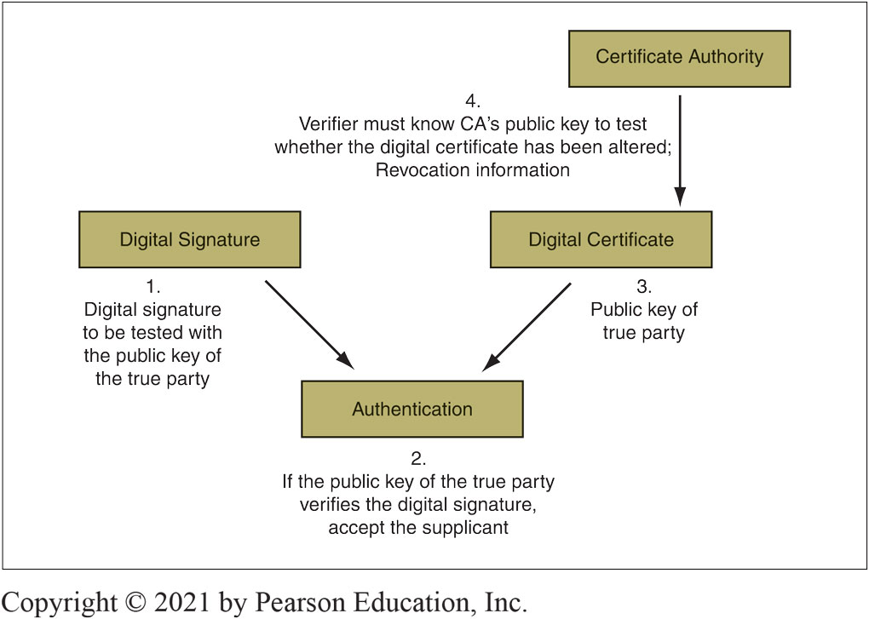
Figure 3-21: Digital Signature and Digital Certificate in Authentication
Notes:
A digital certificate does not, by itself, authenticate a supplicant. As this figure shows, certificates merely provide the public key of the true party for the verifier to use to make the authentication. Anyone can have the true party’s digital certificate without being the true party, so just having the digital certificate does not authenticate the person or process having the certification.

Slide 22
3.7: Message-by-Message Authentication (3 of 10)
Cannot use the sender’s public key
It would always “validate” the sender’s digital signature
Normally requires a digital certificate
File provided by a certificate authority (CA)
The certificate authority must be trustworthy
Digital certificate provides the subject’s (True Party’s) name and public key
Don’t confuse digital signatures and the digital certificates used to test digital signatures!

Slide 23
3.7: Message-by-Message Authentication (4 of 10)
Testing the Digital Signature
The digital certificate has a digital signature of its own
Signed with the Certificate Authority’s (CA’s) private key
Must be tested with the CA’s well-known public key
If the test works, the certificate is authentic and unmodified

Slide 24
3.7: Message-by-Message Authentication (5 of 10)
Checking the Valid Period
Certificate is valid only during the valid period in the digital certificate (not shown in the figure)
If the current time is not within the valid period, reject the digital certificate

Slide 25
3.7: Message-by-Message Authentication (6 of 10)
Checking for Revocation
Certificates may be revoked for improper behavior or other reasons
Revocation must be tested
Cannot be done by looking at fields within the certificate
Receiver must check with the CA

Slide 26
3.7: Message-by-Message Authentication (7 of 10)
Checking for Revocation
Verifier may download the entire certificate revocation list from the CA
See if the serial number is on the certificate revocation list
If so, do not accept the certificate
Or the verifier may send a query to the CA
Requires the CA to support the Online Certificate Status Protocol

Slide 27
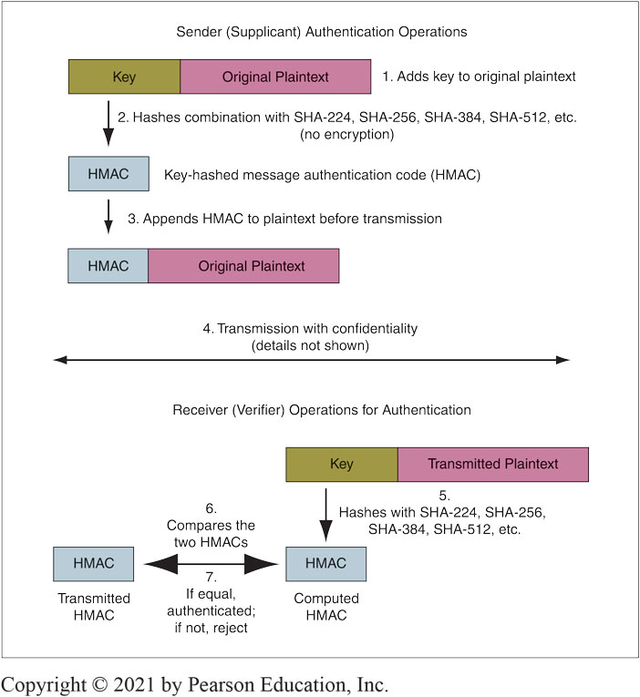
Figure 3-22: Key-Hashed Message Authentication Code (HMAC)
Notes:
The HMAC uses a key exchanged during the initial negotiation phase. However, it does not use this key for symmetric key encryption. Rather, as this figure shows, the sender adds the key to each outgoing message (1), then hashes the combined message and key (2). This hash is the key-hashed method authentication code (HMAC). The sender adds the HMAC to the message (3) and then encrypts this combined bit stream with symmetric key encryption (4).

Slide 28
3.7: Message-by-Message Authentication (8 of 10)
Also Brings Message Integrity
If the message has been altered, the authentication method will fail automatically
Digital Signature Authentication
Uses public key encryption for authentication
Very strong but expensive

Slide 29
3.7: Message-by-Message Authentication (9 of 10)
Key-Hashed Message Authentication Codes
An alternate authentication method using hashing
Much less expensive than digital signature authentication
Much more widely used

Slide 30
3.7: Message-by-Message Authentication (10 of 10)
Nonrepudiation
Means that the sender cannot deny that he or she sent a message
With digital signatures, the sender must use his or her private key
It is difficult to repudiate that you sent something if you use your private key
With HMACs, both parties know the key used to create the HMAC
The sender can repudiate the message, claiming that the receiver created it

Slide 31
3.8: Quantum Security (1 of 2)
Quantum Mechanics
Describes the behavior of fundamental particles
Complex and even weird results
Quantum Key Distribution
Transmits a very long key—as long as the message
A one-time key that will not be used again
A one-time key as long as a message cannot be cracked by cryptanalysis
If an interceptor reads part of the key in transit, this will be immediately apparent to the sender and receiver

Slide 32
3.8: Quantum Security (2 of 2)
Quantum Key Cracking
Tests many keys simultaneously
If quantum key cracking becomes capable of working on long keys, today’s strong key lengths will offer no protection

Slide 33
3.9: Cryptographic Systems
Cryptographic Systems
Combine all cryptographic protections, including confidentiality, authentication, and integrity into a single system
Protect user dialogues from attackers and eliminate the need for users to understand the specific cryptographic details

Slide 34
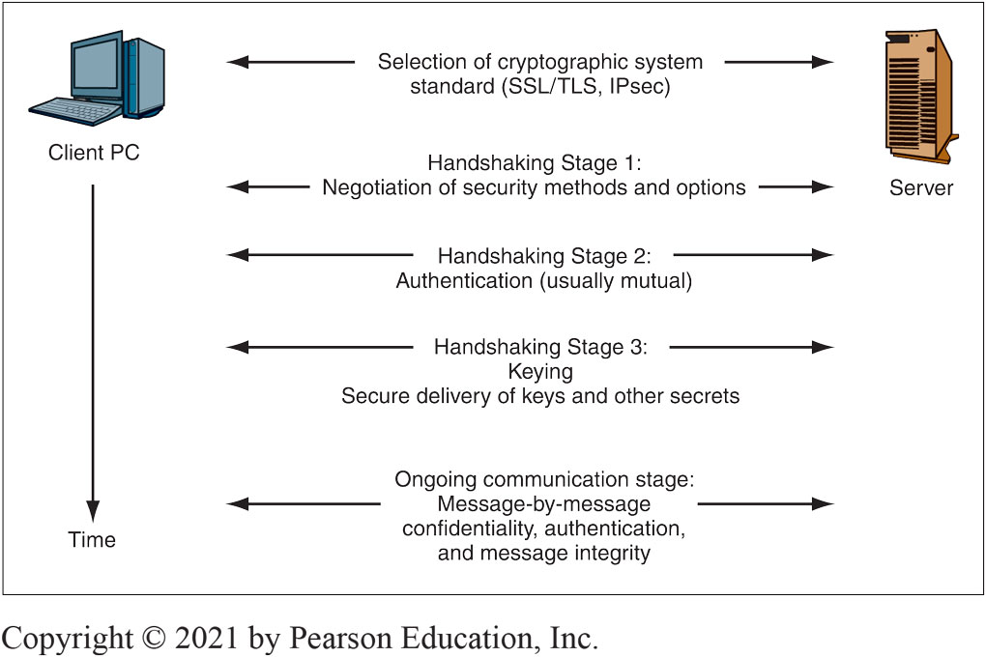
Figure 3-24: Cryptographic System
Notes:
The first task in establishing a cryptographic system is selecting a cryptographic system standard for the dialogue. This figure shows that after selecting a cryptographic system standard the remaining handshaking stages are performed.

Slide 35
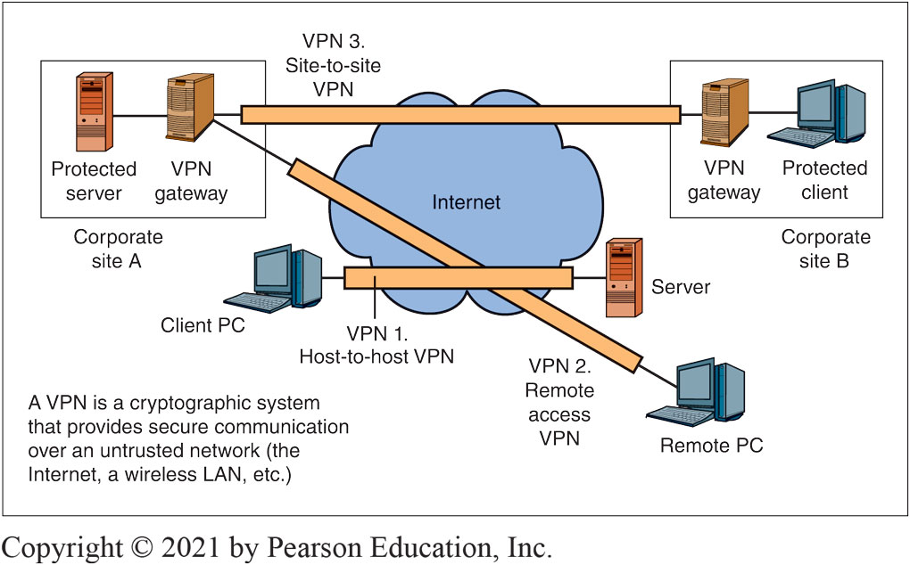
Figure 3-25: Virtual Private Networks (VPNs)
Notes:
Cryptographic systems are often used over untrusted networks. This figure shows that a virtual private network (VPN) is created by using a cryptographic system to secure communication over an untrusted network (the Internet, a wireless LAN, etc.).individual hosts within the site.
This figure illustrates three types of VPNs. The simplest type is the host-to-host VPN. As exemplified by VPN 1, a host-to-host VPN connects a single client over an untrusted network to a single server.
In turn, a remote access VPN connects a single remote PC over an untrusted network to a site network (see VPN 2).
Finally, site-to-site VPNs (see VPN 3) protect all traffic flowing over an untrusted network between a pair of sites.

Slide 36
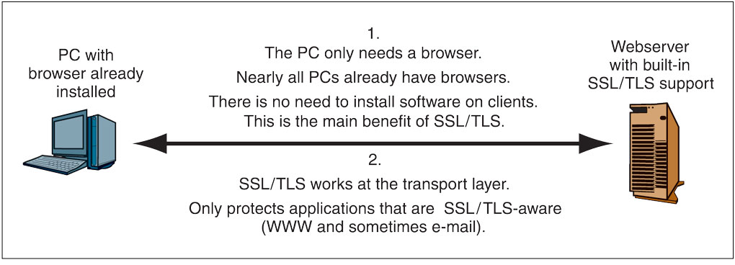
Figure 3-26: Host-to-Host SSL/TLS VPN
Notes:
When you make a purchase over the Internet, your sensitive traffic is almost always protected by a cryptographic system standard that was originally called Secure Sockets Layer (SSL) when the Netscape Corporation created it. Netscape passed the standardization effort to the Internet Engineering Task Force (IETF), which renamed the standard Transport Layer Security (TLS) to emphasize that it works at the transport layer. We will refer to it asSSL/TLS, but in actual practice, people simply call it SSL or TLS. This figure shows how an SSL/TLS host-to-host VPN operates.

Slide 37
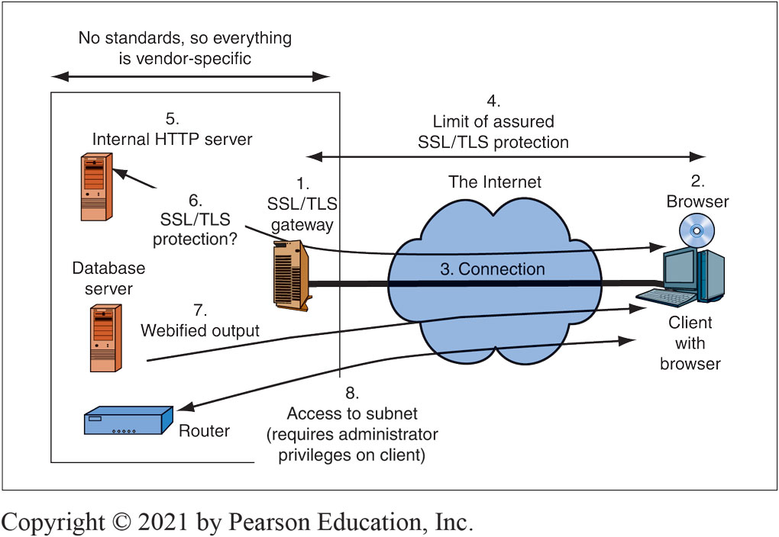
Figure 3-27: SSL/TLS and Remote Access VPN Using a Gateway
Notes:
As Figure 3-27 shows, to convert SSL/TLS from a host-to-host VPN to a remote access VPN, firms place an SSL/TLS gateway at the border of each site (1). The remote client’s browser (2) establishes a single SSL/TLS connection with the SSL/TLS gateway (3), rather than with
individual hosts within the site.

Slide 38
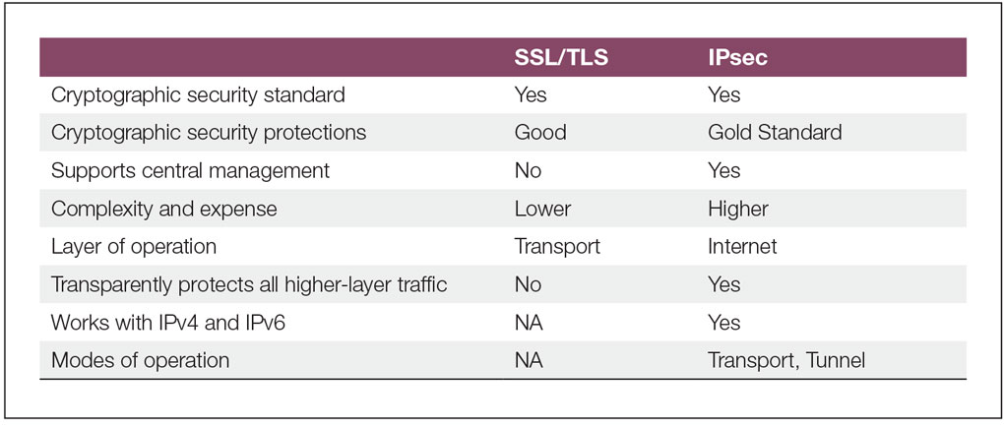
Figure 3-28: IP Security (IPsec) versus SSL/TLS
Notes:
Figure 3-28 compares IPsec with the SSL/TLS cryptographic security standard. IPsec is more complex and therefore more expensive to introduce than SSL/TLS, but IPsec is the gold standard in VPN security. It offers the strongest protections and supports centralized corporate control over all IPsec operation on all devices.

Slide 39
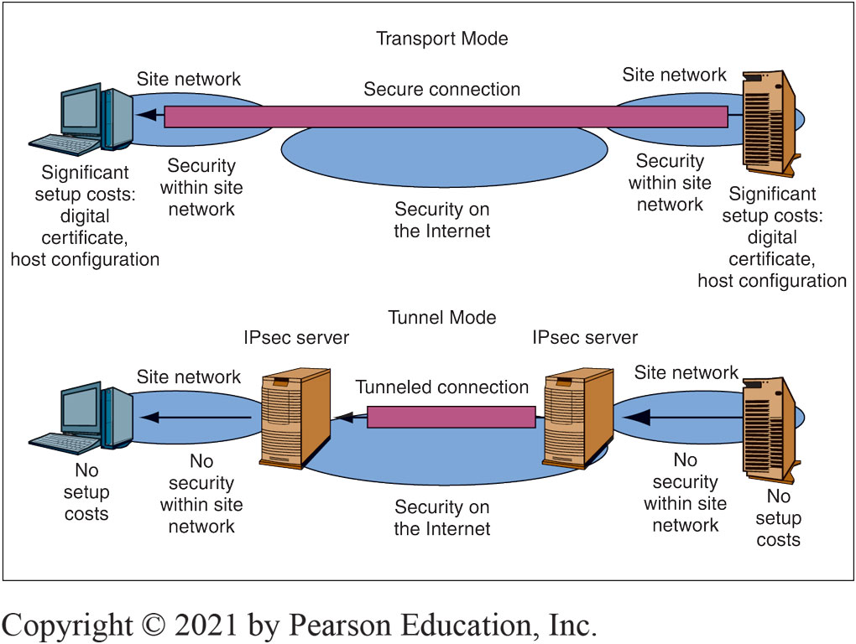
Figure 3-29: IPsec Operation: Tunnel and Transport Modes
Notes:
In IPsec, there are two operating modes: the transport mode and the tunnel mode. Figure 3-29 illustrates how these two modes work. Figure 3-30 compares their characteristics in a table.
M03_

Slide 40
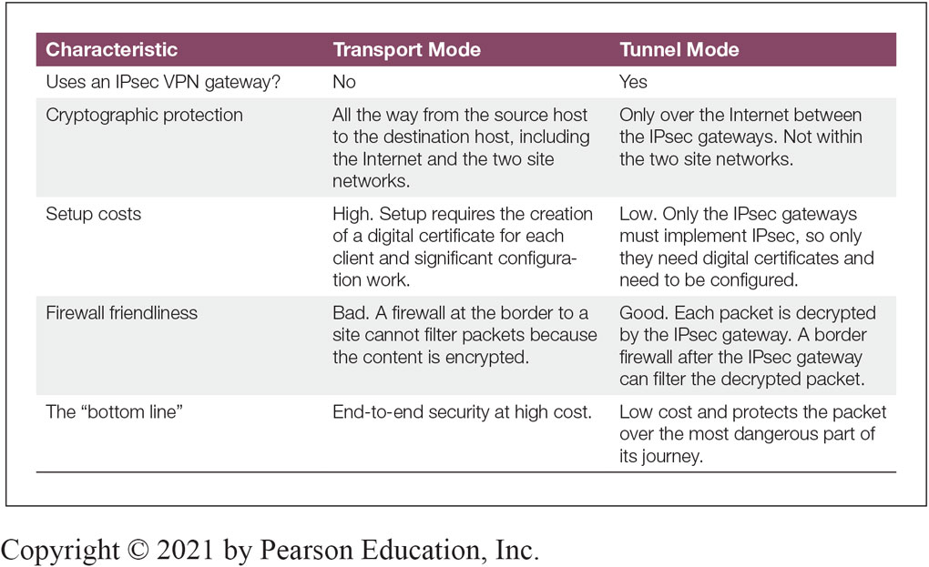
Figure 3-30: Comparing IPsec Transport and Tunnel Modes

Slide 41
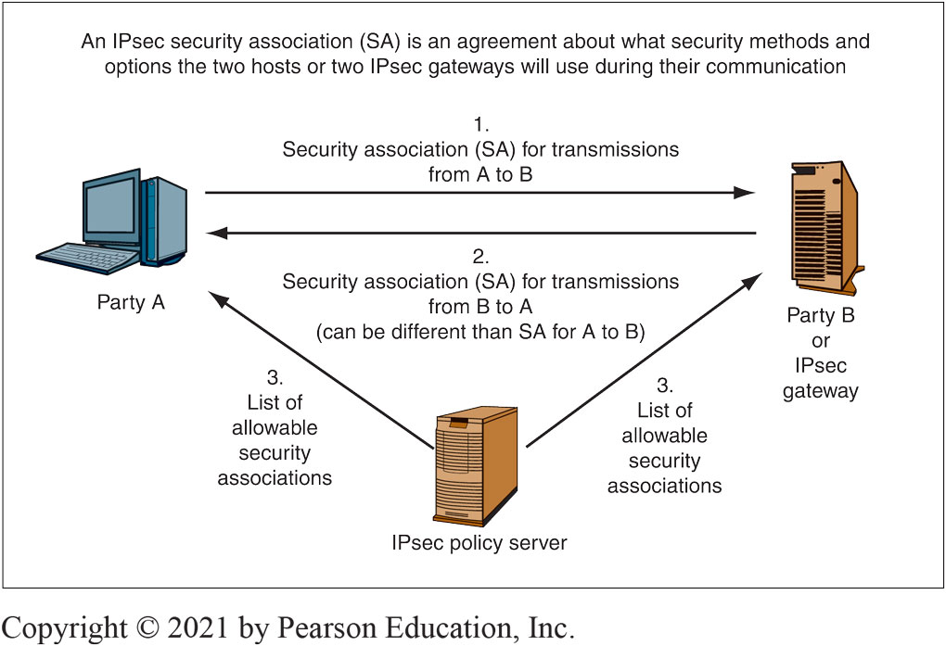
Figure 3-31: IPsec Security Associations
Notes:
Figure 3-31 illustrates how communicating partners negotiate security associations.

Slide 42

Copyright
This work is protected by United States copyright laws and is provided solely for the use of instructors in teaching their courses and assessing student learning. Dissemination or sale of any part of this work (including on the World Wide Web) will destroy the integrity of the work and is not permitted. The work and materials from it should never be made available to students except by instructors using the accompanying text in their classes. All recipients of this work are expected to abide by these restrictions and to honor the intended pedagogical purposes and the needs of other instructors who rely on these materials.

